Slide 1
GEORGIA ADVENTURE
6 nights 7 days

Slide 2
SPEND YOUR 6 DAY IN GEORGIA
TBILISI
MTSKHETA
KAZBEGI
ANANURI
KUTAISI
MARTVILI
MESTIA
USHGULI

Slide 3
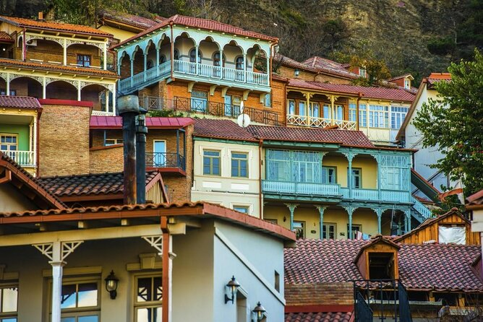
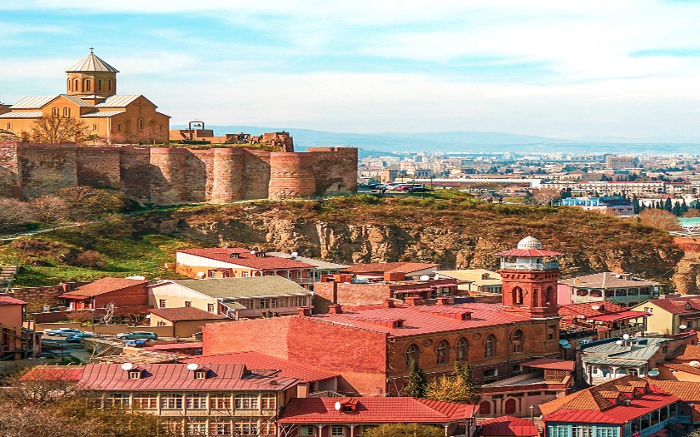
DAY 1
Old Tbilisi
Narikala fortress and the mother of Georgia monument
European square, liberty square, trinity church, Dinner and overnight in Tbilisi

Slide 4
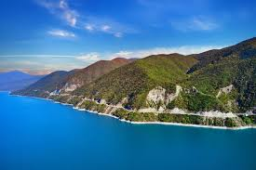
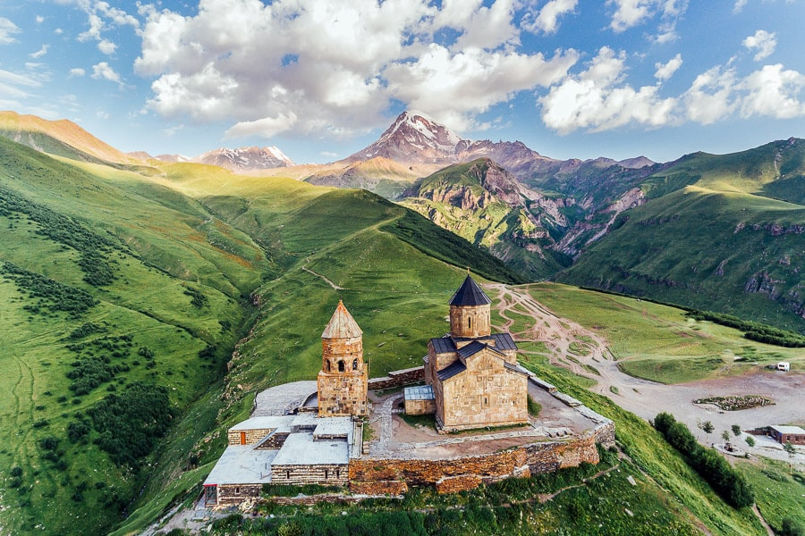
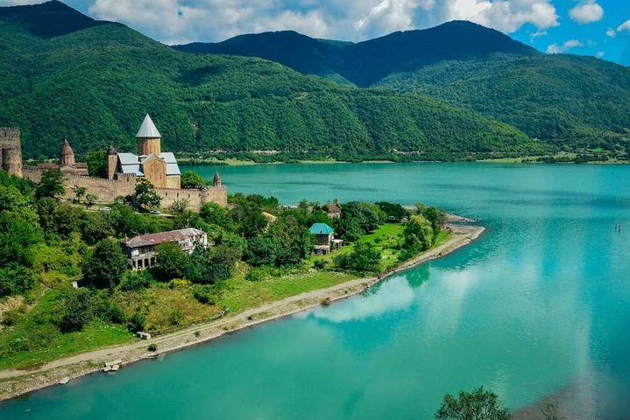
DAY 2
Zhinvali Lake ( Reservoir)
Ananuri
Kazbegi
Return to Tbilisi

Slide 5
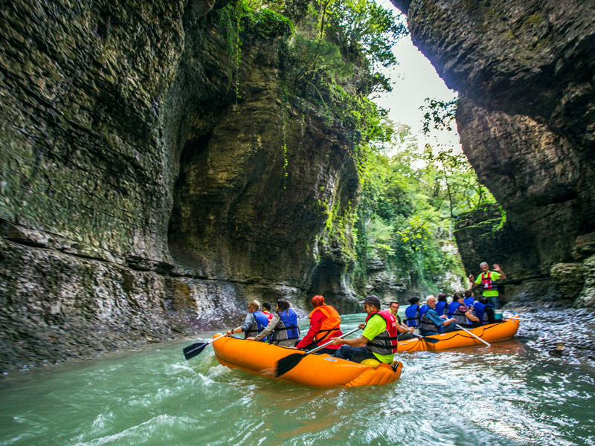
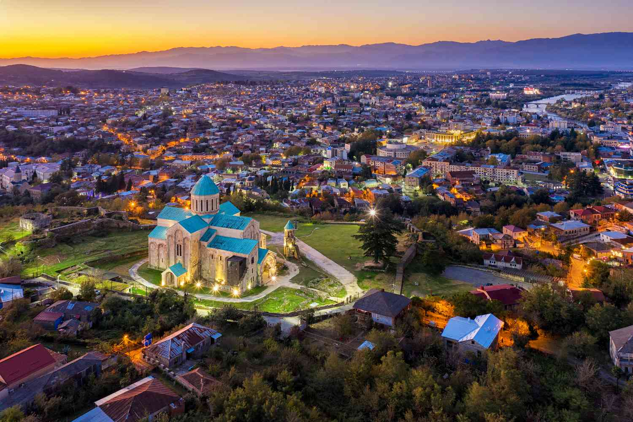
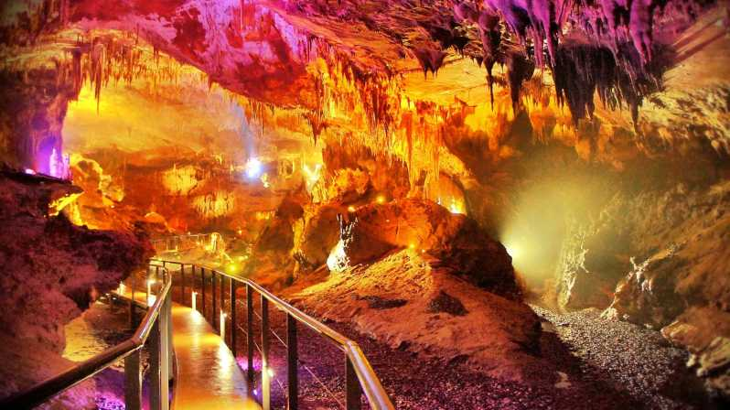
DAY 3
Visit to Kutaisi
Sataplia cave
Martvili Canyon

Slide 6
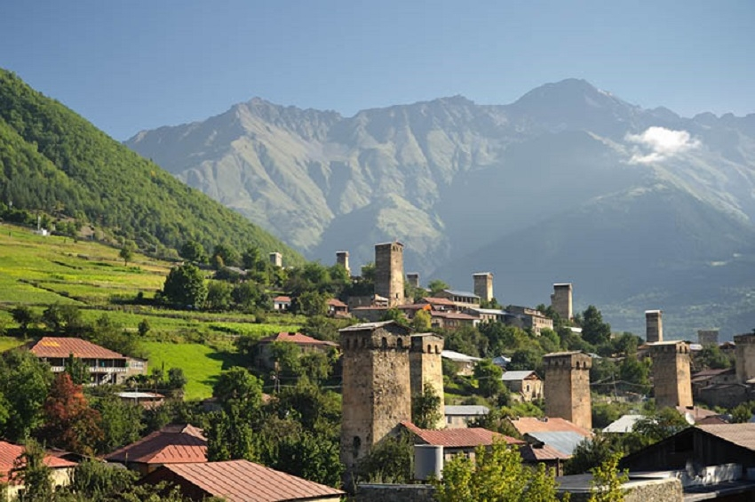
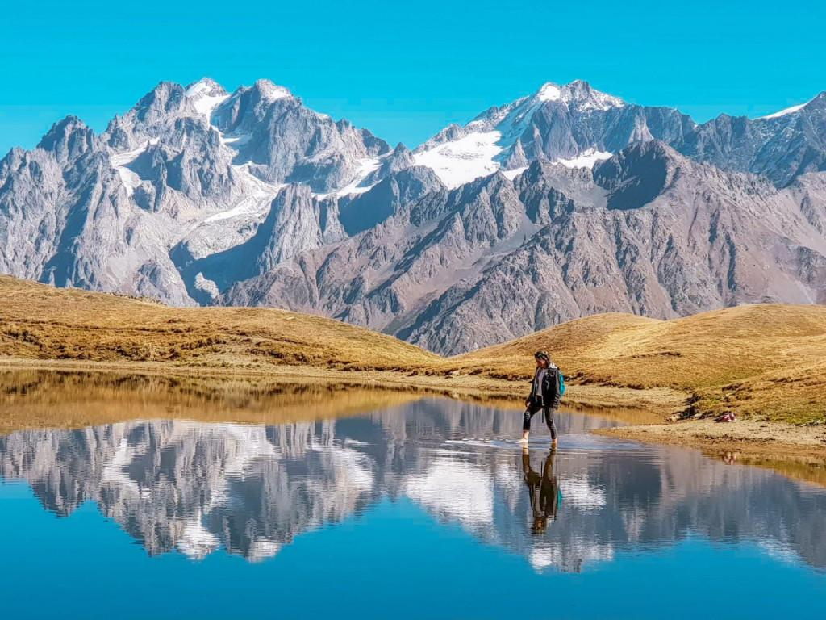
DAY 4
Travel from Martvili to Mestia (approximately 3-4 hours)
Visit Defance Tower
Hatsval Mountain
KORULDI LAKE

Slide 7
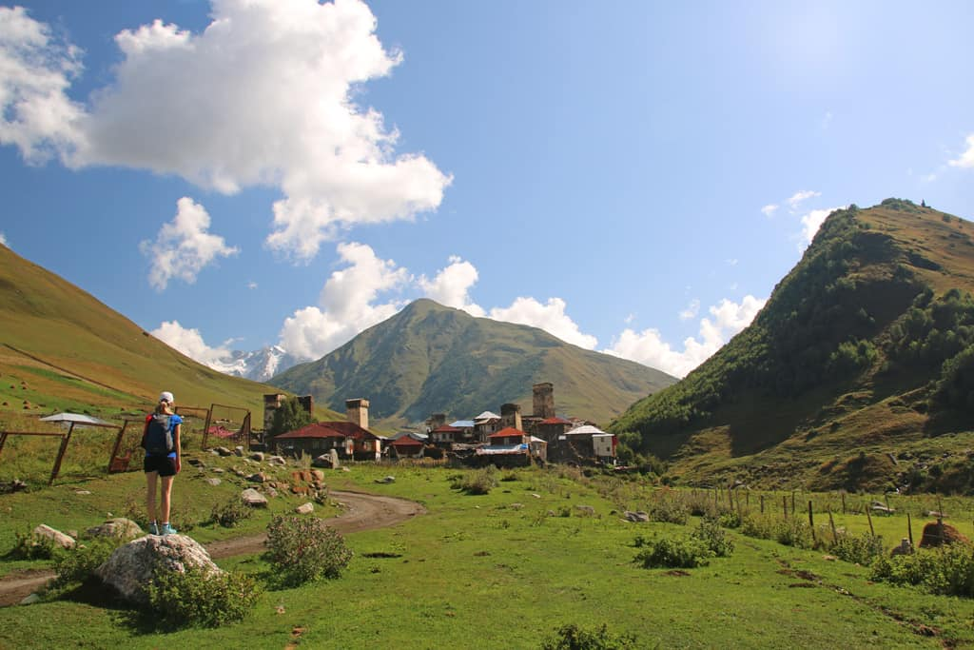
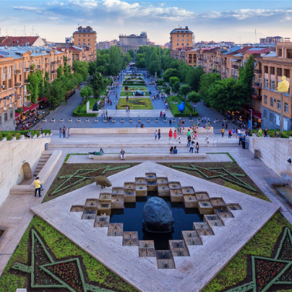
DAY 5
MESTIA TO USHGULI TREK

Slide 8
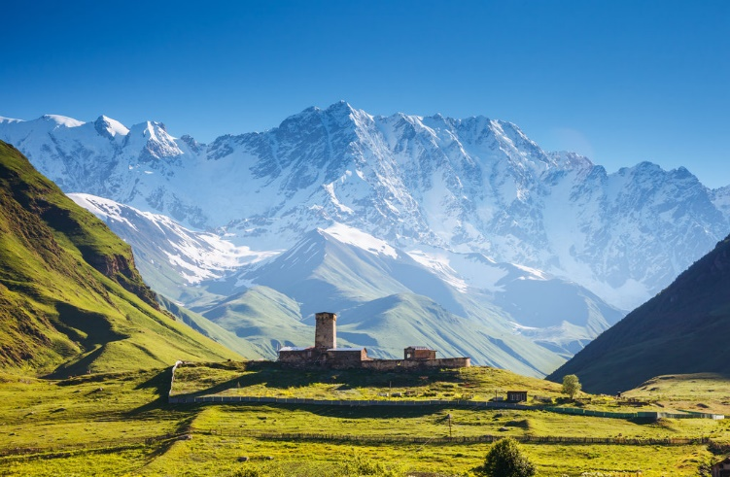
Day 6
USHGULI TO SHKHARA BY HORSE
RETOURN TO MESTIA BY CAR

Slide 9
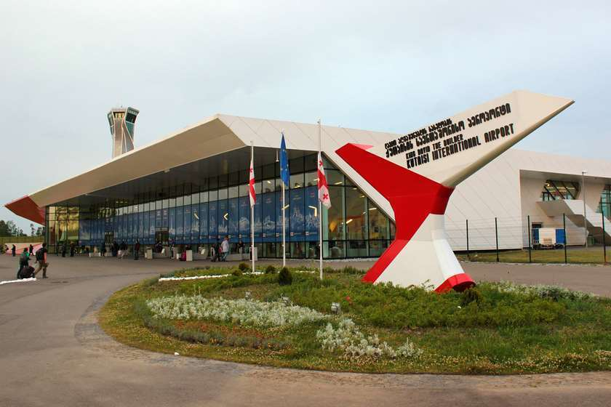
DAY 7
MESTIA TO KUTAISI AIRPORT

Slide 10
Package
Air tickets | Transfers | Accommodation | Meals | Travel insurance
Kutaisi-barcelona or Madrid | Yes | Yes | BB | Yes
Subtotal:1500 $ for two person

Slide 11
THANKS!
Do youhave anyquestions?
Credohotelgroup@gmail.com
+ 995 571 90 39 68
32 2 72 21 41
www.credo.tour
Georgia, Tbilisi,Ts.Dadiani 7,office 210 A
Post code 0101

